Slide 1


SAP S/4HANA Training
MASTER DATA GOVERNANCE (SAP MDG)
Neeraj Gupta
Session10
SAP MDG – Data Quality and Search

Slide 2
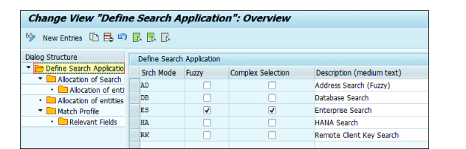
10
SAP MDG – Data Quality and Search
Define Search Applications

Slide 3
10
SAP MDG – Data Quality and Search
Fuzzy search for BAS

Slide 4
10
SAP MDG – Data Quality and Search
Customer incidents
Components for Incidents
BC-EIM-ESH
CA-MDG-APP-MM / Data Model
Transaction Codes for ES
ESH_ADM_SERVER_GROUP Set Server Group
ESH_ADM_TREX_DEST Set TREX Destination
ESH_COCKPIT Connector Administration Cockpit
ESH_MODELER Search & Analytics Modeler
ESH_SEARCH Enterprise Search UI (only ERP)
ESH_TEST_SEARCH Test Search
Composite role SAP_ESH_SEARCH

Slide 5
10
SAP MDG – Data Quality and Search
SAP HANA Enterprise Search

Slide 6
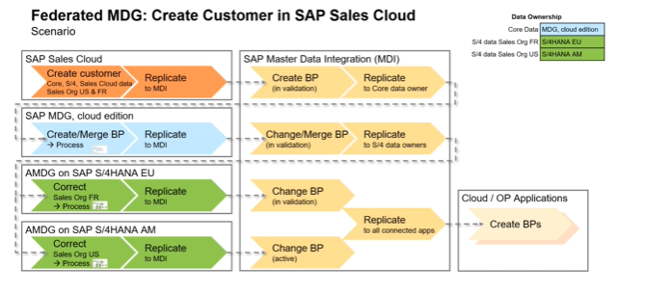
10
SAP MDG – Data Quality and Search
Federated Master Data Governance (Example Create Customer)
With SAP HANA-based search for MDG, the federated search is not supported

Slide 7
10
SAP MDG – Data Quality and Search
SAP HANA search View in SAP MDG

Slide 8
10
SAP MDG – Data Quality and Search
Configure web Dynpro component SE80

Slide 9
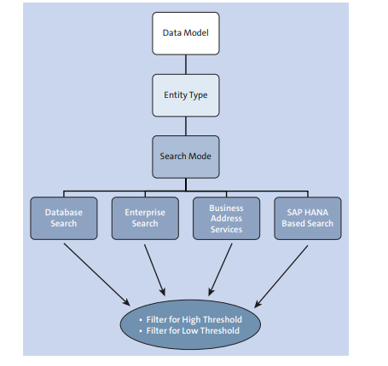
10
SAP MDG – Data Quality and Search
Duplicate Check Configurations

Slide 10

End of Session 10

Slide 11

Questions

Slide 12

Neeraj gupta

Slide 13


We’re committed to empower you to be
Most Desirable Resource
through powerful training solutions.
We build the workforce of the future.
250+
Corporate Clients
30,000+
Learners Trained
25000+
Learners Placed
FREE WEBINARS
Sign up for free webinars with industry experts every fortnight!
Enroll Now!
Contact us today!
https://anubhavtrainings.com/

Slide 14




More from AnubhavTrainings.com

